Slide 1
Context
I created these slides to illustrate/explain my design for a Local Play and Companion App mode for Ticket to Ride.

Slide 2


Slide 3
What is Local Play and How to Play
Local Play is a game mode for Steam and Consoles that allow players to play together in the same room.
The Local Play mode is played with the help of a Free Companion App which can be downloaded from the App Store or Google Play stores.
The Free Companion App allows players to play together in the same room while still keeping their cards/clue sheet hidden from others.
The Local Play game mode requires players to interact with both the hosting platform and their mobile devices.
The companion app must have a different name so it does not compete with the paid app on search engines.
The companion app must be a simple, stripped down version of the main app that does not work without the hosting platform.

Slide 4
Local Play Flow

Slide 5
Guidelines
Companion App Play only exists on Steam and Consoles (it does not exist on mobile, unlike Pass and Play).
All companion app players will share the same content as the host (characters, and colours).
Companion app play does not feature Carriage and Locomotive customisation.
The Companion App is a lighter version of the game, designed to allow players to interact with the game, it does not have all of the visuals of the paid app.
The TV, on the other hand, will show the usual 3D map, train animations etc
Companion app is set to Fast Mode with no option to toggle on relaxed mode, TV uses whichever setting the user has set.
The free companion app saves the metagame progress of the host player (nice to have).

Slide 6
Platform Flow
Local Game Intro
Lobby
Game Modes
Board
Gameplay
Lobby
Companion App Flow
Splash Screen
Select User
Enter Code
Conn.
Confirm.
Gameplay
Lobby
Shared Flow
TV Flow
Host Flow
Guest Flow
‹#›

Slide 7
Front End Moments
Game Modes | Game Modes menu with a new option: LOCAL PLAY, or Two Step option nested within an existing option
Local Play Intro | A screen that has information on the game mode and the Code for the local game room
Enter Code | Options to enter code, change name or enter the Settings Menu
Connection Confirmation | Confirms the player connection and informs player of how to start the game.
Select User | Screen that prompts players to either continue as a guest or take the role of the Host
Select Board | Board selection menu from the paid app
Game Type | Clock selection menu from the paid app
Lobby | Lobby menu from the paid app
Customisation | Character selection menu from the paid app
Edit AI | Edit AI menu from the paid app
Settings | Settings menu with options for: SFX, Language, Vibrations

Slide 8
Gameplay Moments
Loading
Deciding First Player
Dealing Cards
Selecting Tickets
Drawing Train Cards
Drawing New Tickets
Claiming a Route
Finishing a Tunnel
Inspecting Tickets
Completing a Ticket
Building a Station
Using a Station
Longest Route
Final Scores
Game Settings

Slide 9
Mockups Legend

Slide 10
TV
TV Screen
Host/Active Player
Guest/Passive Player
Host/Active Mobile Screen
Guest/Passive Mobile Screen

Slide 11
Legend
Character
Continue
Enter
Image
Button
Non-Interactive Button
Settings

Slide 12
Front End

Slide 13
Nesting 1
Online and Online with Friends nested into one ‘Online’ menu option, Pass and Play and Companion app nested into one ‘Local’ option.
TV
Select Game Mode
Single Player
Online
Async
Local
Play offline against up to 5 AI opponents
Play multiplayer online against friends or random opponents
Play with your friends using a private room code
Play locally with pass and play or using the free companion app
Back
Host/Active Player
Guest/Passive Player

Slide 14
Nesting 2
Online with Friends, Pass and Play, and Companion app games nested into a ‘Play with Friends’ menu option.
TV
Select Game Mode
Single Player
Online
Async
Play with Friends
Play offline against up to 5 AI opponents
Play multiplayer online against random opponents
Play long form games
Play with friends online, or locally
Back
Host/Active Player
Guest/Passive Player

Slide 15
No Nesting 1
TV
Companion app play added as a new option, no nesting
Select Game Mode
Companion App
Single Player
Online
Async
Play a local game on multiple devices
Online with Friends
Play offline against up to 5 AI opponents
Play multiplayer online against random opponents
Play long form games
Pass and Play
Play with friends online
Play a local game on one device
Back
Host/Active Player
Guest/Passive Player

Slide 16
No Nesting 2
TV
Companion app play added as a new option, no nesting
Select Game Mode
Pass and Play
Companion App
Single Player
Online
Play a local game on one device
Play a local game on multiple devices
Play offline against up to 5 AI opponents
Play multiplayer online against random opponents
Async
Online with Friends
Play with friends online
Play long form games
Back
Host/Active Player
Guest/Passive Player

Slide 17
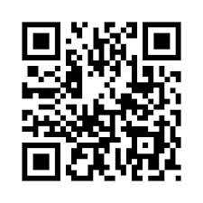
Companion App Intro Screen
Selecting the Companion app option takes players to an overview screen.
Here, the TV Screen displays instructions on how to download the Free Companion App via QR Code (which takes players to the Companion App store page).
TV
Play Ticket to Ride around the big screen! To play, each player needs a mobile device with the free official Ticket to Ride companion app installed.
Players can also use the Platform's Controller to go back to the previous menu or to launch companion app mode, which creates a lobby with a room code for companion app players to join.
DOWNLOAD
Free Ticket to Ride Companion app
- Install and launch the app on your mobile device
- When everyone has installed the app, press continue to begin setting up the game
Back
Continue
Back
Host/Active Player
Guest/Passive Player

Slide 18
Splash Screen
The Splash Screen is the first screen that players see when opening the Companion App (after the logos).
This screen shows a brief explanation of what the Companion App aims to be and how to use it.
Play Ticket to Ride around the big screen! To play, each player needs a mobile device with the free official Ticket to Ride companion app installed.
Pressing Start will take players to the next step.
DOWNLOAD
Free Ticket to Ride Companion app
- Install and launch the app on your mobile device
- When everyone has installed the app, press continue to begin setting up the game
Play!
Back
Ticket To Ride
Ticket to Ride
(Splash Screen)
(Splash Screen)
Press to Start
Press to Start

Slide 19
Name Input
Room code ####
Players are now asked to input a name on this screen. They can:
Use a pre-generated username
or edit username (which opens the device’s keyboard).
Back
Players
The 1st player to select a user (either platform user or not), becomes the Host of the game (check next slide).
Play Ticket to Ride around the big screen! To play, each player needs a mobile device with the free official Ticket to Ride companion app installed.
Play Ticket to Ride around the big screen! To play, each player needs a mobile device with the free official Ticket to Ride companion app installed.
Set Up Your Game
Char 1
Char2
Char 3
Char 4
Char 5
DOWNLOAD
Free Ticket to Ride Companion app
- Install and launch the app on your mobile device
- When everyone has installed the app, press continue to begin setting up the game
DOWNLOAD
Free Ticket to Ride Companion app
- Install and launch the app on your mobile device
- When everyone has installed the app, press continue to begin setting up the game
i
i
i
Host
Difficulty
Difficulty
Difficulty
Difficulty
Continue
Select Map
Change Turn Length
Play!
Room code ####
Play!
Back
Room code ####
Back
Guest/Passive Player
Username
Username
Edit
Edit
Continue
Continue
Quit
Quit

Slide 20
Select Board V2
The host player makes the selection of the board using the controller or mouse and keyboard.
Advancing beyond this screen creates a Companion App lobby.
TV
Back
Host choosing map…
✔
USA
Map Rules
Europe
Map Rules
Continue
Host/Active Player
Guest/Passive Player

Slide 21
Enter Username and Room Code
Room code ####
After confirming their choice of username, the player now enters the room code to join the lobby.
Back
Players
Play Ticket to Ride around the big screen! To play, each player needs a mobile device with the free official Ticket to Ride companion app installed.
Set Up Your Game
Char 1
Char2
Char 3
Char 4
Char 5
DOWNLOAD
Free Ticket to Ride Companion app
- Install and launch the app on your mobile device
- When everyone has installed the app, press continue to begin setting up the game
i
i
i
Host
Difficulty
Difficulty
Difficulty
Difficulty
Play!
Back
Room code ####
Play!
Host/Active Player
Guest/Passive Player
Enter the code displayed on the TV to join the game
Enter the code displayed on the TV to join the game
Username
Username
Edit
Edit
_ _ _ _
_ _ _ _
Join Game
Join Game

Slide 22
Connection Confirmation Menu
When a player selects his/her username, the companion app informs the player that they are connected with the selected username to the available room.
Play Ticket to Ride around the big screen! To play, each player needs a mobile device with the free official Ticket to Ride companion app installed.
The game advances to the next step the moment a player presses the Play option with the Platform Controller.
DOWNLOAD
Free Ticket to Ride Companion app
- Install and launch the app on your mobile device
- Enter the passcode to join the lobby
- Join with your (platform’s username) to save your Meta Game Progress
Back
Continue
YOU ARE CONNECTED AS
(username)
You are the Host
Press Play with the (platform) controller to start the game.
YOU ARE CONNECTED AS
(username)
Press Play with the (platform) controller to start the game.
Quit
Continue
Quit

Slide 23
Game Lobby V1
TV
All players can access customisation from this screen.
The host is also able to setup any AI players they would like to include in the game on this screen.
Players are arranged in the order they join the lobby.
Players can set ready on their companion app.
Back
Set Up Your Game
Room code ####
Char1
Char2
Char3
Char4
Char5
Host
Ready
Not Ready
Difficulty
Difficulty
Host/Active Player
Guest/Passive Player
Back
Set Up Your Game
Back
Set Up Your Game
Char 1
Char2
Char 3
Char 4
Char 5
Char
1
Char
2
Char
3
Char
4
Char
5
i
i
i
i
Host
Ready/ Difficulty
Ready/ Difficulty
Difficulty
Difficulty
Host
Ready
Not Ready
Difficulty
Difficulty
Play!
Ready

Slide 24
Game Lobby V2
TV
They cannot add additional players, these are added when a player connects with the Companion app.
Companion Apps display a waiting to start message once the player joins the lobby
On this screen the host player sets up AI, and other players customisation using the controller (or mouse and keyboard) in the same way they would set up a Pass and Play game.
Back
Set Up Your Game
Room code ####
Char1
Char2
Char3
Char4
Char5
Host
Difficulty
Difficulty
Play!
Host/Active Player
Guest/Passive Player
Back
Back
Waiting to start…
Waiting to start…

Slide 25
Customisation V1
If players access the customisation menu it is displayed on their companion app device, not the TV screen, regardless of whether they are the host or a guest. AI appearance is customised in the same manner.
The TV screen continues to display the Lobby to keep players informed of changes.
TV
Back
Set Up Your Game
Room code ####
Char1
Char2
Char3
Char4
Char5
Host
Ready
Not Ready
Difficulty
Difficulty
Host/Active Player
Guest/Passive Player
Back
Customisation
Back
Customisation
Colour
Character
Locomotive
Carriage
Colour
Character
Locomotive
Carriage
Option
Option
Option
Option
Option
Option
Option
Option
Option
Option
Option
Option
Option
Option
Option
Option
Option
Option
Option
Option

Slide 26
Customisation V2
Customisation for all players and AI is handled by the host player using the controller/mouse and keyboard.
Locomotives and Carriages are locked to default and cannot be customised.
Companion App displays a ‘waiting to start message’
TV
Back
Customisation
Room code ####
Colour
Character
Option
Option
Option
Option
Option
Option
Option
Option
Option
Option
Host/Active Player
Guest/Passive Player
Back
Back
Waiting to start…
Waiting to start…

Slide 27
Change AI Difficulty V2
The host can change the AI difficulty on their companion app.
The TV screen continues to display the Lobby to keep players informed of changes.
The host has a start game button, which is greyed out until all players set Ready.
TV
Back
Set Up Your Game
Room code ####
Char1
Char2
Char3
Char4
Char5
Host
Ready
Not Ready
Difficulty
Difficulty
Start Game
Host/Active Player
Guest/Passive Player
Waiting to start…
Waiting to start…

Slide 28
Select Board V1
The host player makes the selection of board on their mobile device. The options are displayed on all screens, but only interacted with on the host player’s device.
Players can view map rules on their own device
TV
Back
Host choosing map…
Room code ####
✔
USA
Europe
Host/Active Player
Guest/Passive Player
Back
Choose a Map
Back
Host choosing map…
✔
✔
USA
USA
Map Rules
Map Rules
Europe
Europe
Map Rules
Map Rules
Continue

Slide 29
Select Game Length
The host player makes the selection of turn length on their mobile device. The options are displayed on both the host’s device and the TV screen.
Long Distance clock types are not included.
TV
All remaining players see the Lobby screen where they can:
Access the customisation menu
Set Ready
Players are arranged in the order they entered the lobby.
Back
Choose Game Length
Room code ####
Blitz
Normal
Relaxed
Host/Active Player
Guest/Passive Player
Back
Choose Game Length
Back
Set Up Your Game
Blitz
Normal
Relaxed
Char
1
Char
2
Char
3
Char
4
Char
5
i
Host
Ready
Not Ready
Difficulty
Difficulty
Ready

Slide 30
Game Lobby (Option B)
The host player determines the game board and game length. Both the Host Companion App and the TV Screen will display the Select Game Board and Select Game Length menus.
Those menus are displayed before reaching the game lobby, and those options cannot be edited once the lobby is created.
The host is also able to customise any AI players. And add or remove AI.
TV
Back
Set Up Your Game
Room code ####
All remaining players see the Lobby screen where they can:
Access the customisation menu
Set Ready
Players are arranged in the order they entered the lobby.
Char1
Char2
Char3
Char4
Host
Ready
Not Ready
Difficulty
Waiting…
Host/Active Player
Guest/Passive Player
Back
Set Up Your Game
Back
Set Up Your Game
X
Char 1
Char2
Char 3
Char 4
Char
1
Char
2
Char
3
Char
4
i
i
i
Add AI
Host
Ready/ Difficulty
Ready/ Difficulty
Difficulty
Waiting…
Host
Ready
Not Ready
Difficulty
Waiting…
Play!
Ready

Slide 31
Companion App Settings
TV
The Settings Option will appear in almost all the menus of the frontend, allowing players to configure key settings of the game before starting a game.
Back
Set Up Your Game
Room code ####
Possible configurations:
SFX (companion app)
Language (companion app)
Privacy Policy & Terms of Use
Vibration
Note: Companion apps always set to Fast Mode, this cannot be changed. TV is on relaxed mode by default, but can be changed to fast mode.
Char1
Char2
Char3
Char4
Char5
Host
Ready
Not Ready
Difficulty
Difficulty
CL number
Settings
CL number
Settings
SFX
SFX
Language
English (GB)
Language
English (GB)
Vibration
Vibration
Back
Privacy Policy
Terms of Use
Back
Privacy Policy
Terms of Use

Slide 32
Companion App Sound
 | TV | Active Player | Passive Player
Music | ✔ | ✘ | ✘
Train Placement | ✔ | ✔ | ✘
Drawing Cards or Tickets | ✔ | ✔ | ✘
UI Feedback | ✘ | ✔ | ✔
Ticket Stamped | ✘ | ✘ | ✘

Slide 33
Gameplay

Slide 34
Loading Screen
Once all players are ready the game goes to the Loading Screen.
Loading…
Loading…
Loading…

Slide 35

Deciding First Player
The scene of deciding the first player happens on the TV screen.
Companion App prompts all players to look at the TV screen.
Player 1
Player 2
Player 3
Player 4
Player 5
Something important is happening on the big screen!
Something important is happening on the big screen!

Slide 36
Starting Train Cards
Train cards begin in the player’s hand as they do in regular app play.
No hand cards are displayed on the TV.
Ticket Deck
Player 1 Info
Train Card
Player 2 Info
Train Card
Player 3 Info
Train Card
Train Card
Player 4 Info
Train Card
Player 5 Info
Train Deck
Ticket Deck
Ticket Deck
Opponent Info
Train Card
Opponent Info
Train Card
Opponent Info
Train Card
Opponent Info
Train Card
Opponent Info
Train Card
Opponent Info
Train Card
Opponent Info
Train Card
Opponent Info
Train Card
Train Card
Train Card
Player Info
Hand Card
Hand Card
Hand Card
Hand Card
Hand Card
Train Deck
Player Info
Train Card
Train Deck
Hand Card
Hand Card

Slide 37
Dealing Tickets
The animation of tickets being dealt to each player happens on the TV screen. The animation plays out in the same way it does in the paid app.
The companion app also shows the player being dealt their tickets.
Ticket Deck
Player 1 Info
Train Card
Player 2 Info
Train Card
Ticket
Train Card
Player 3 Info
Train Card
Player 4 Info
Train Card
Player 5 Info
Train Deck
Ticket Deck
Ticket Deck
Select 2 or more tickets
Train Card
Select 2 or more tickets
Train Card
Player Info
Player Info
Ticket
Train Card
Train Card
Ticket
Train Card
Train Card
Ticket
Ticket
Train Card
Train Card
Ticket
Ticket
Train Card
Train Card
Player Info
Hand Card
Hand Card
Hand Card
Hand Card
Hand Card
Train Deck
Player Info
Hand Card
Hand Card
Hand Card
Hand Card
Hand Card
Train Deck
Hand Card
Hand Card
Hand Card
Hand Card

Slide 38
Selecting Starting Tickets
Players select and confirm their chosen tickets on the companion app.
Ticket Deck
Player 1 Info
Train Card
Player 2 Info
Train Card
Player 3 Info
Train Card
Train Card
Player 4 Info
Train Card
Player 5 Info
Train Deck
Ticket Deck
Ticket Deck
Select 2 or more tickets
Train Card
Select 2 or more tickets
Train Card
Player Info
Player Info
Ticket
Train Card
Ticket
Train Card
Ticket
Train Card
Train Card
Ticket
Train Card
Train Card
Ticket
Ticket
Train Card
Train Card
Confirm
Hand Card
Hand Card
Hand Card
Hand Card
Hand Card
Train Deck
Confirm
Hand Card
Hand Card
Hand Card
Hand Card
Hand Card
Train Deck
Hand Card
Hand Card
Hand Card
Hand Card

Slide 39
Drawing Train Cards
Active player draws new cards using the companion app. On the TV screen all players can see the cards being drawn.
This is also shown on all players companion apps
Passive players can check opponent info/their own info
Ticket Deck
Player 1 Info
Train Card
Player 2 Info
Train Card
Player 3 Info
Train Card
Train Card
Player 4 Info
Train Card
Train Card
Player 5 Info
Train Deck
Ticket Deck
Ticket Deck
Opponent Info
Train Card
Opponent Info
Train Card
Opponent Info
Train Card
Opponent Info
Train Card
Opponent Info
Train Card
Opponent Info
Train Card
Opponent Info
Train Card
Opponent Info
Train Card
Train Card
Train Card
Train Card
Player Info
Hand Card
Hand Card
Hand Card
Hand Card
Hand Card
Train Card
Train Deck
Player Info
Hand Card
Hand Card
Hand Card
Hand Card
Hand Card
Train Deck
Hand Card
Hand Card
Hand Card
Hand Card

Slide 40
Drawing Tickets
The animation of tickets being drawn happens on the TV screen. The animation plays out in the same way it does in the paid app.
The active player can also see their tickets being drawn on the companion app.
Ticket Deck
Player 1 Info
Train Card
Ticket
Player 2 Info
Train Card
Player 3 Info
Train Card
Train Card
Player 4 Info
Train Card
Player 5 Info
Train Deck
Ticket Deck
Ticket Deck
Select 1 or more tickets
Train Card
Opponent Info
Train Card
Player Info
Ticket
Train Card
Opponent Info
Train Card
Ticket
Train Card
Opponent Info
Train Card
Train Card
Opponent Info
Train Card
Ticket
Train Card
Train Card
Player Info
Hand Card
Hand Card
Hand Card
Hand Card
Hand Card
Train Deck
Player Info
Hand Card
Hand Card
Hand Card
Hand Card
Hand Card
Train Deck
Hand Card
Hand Card
Hand Card
Hand Card

Slide 41
Selecting Drawn Tickets to Keep
The player can view and select which tickets to keep on their companion app.
Ticket Deck
Player 1 Info
Train Card
Player 2 Info
Train Card
Player 3 Info
Train Card
Train Card
Player 4 Info
Train Card
Player 5 Info
Train Deck
Ticket Deck
Ticket Deck
Select 1 or more tickets
Train Card
Opponent Info
Train Card
Player Info
Ticket
Train Card
Opponent Info
Train Card
Ticket
Train Card
Opponent Info
Train Card
Train Card
Opponent Info
Train Card
Ticket
Train Card
Train Card
Confirm
Hand Card
Hand Card
Hand Card
Hand Card
Hand Card
Train Deck
Player Info
Hand Card
Hand Card
Hand Card
Hand Card
Hand Card
Train Deck
Hand Card
Hand Card
Hand Card
Hand Card

Slide 42
Claiming a Route
Active player can claim routes in the same way that they would on the paid app, with instant feedback.
The TV plays the claiming route sequence.
Passive player’s app updates as in paid app.
Ticket Deck
Player 1 Info
Train Card
Train Card
Train Card
Train Card
Player 2 Info
Train Card
Player 3 Info
Train Card
Train Card
Player 4 Info
Train Card
Player 5 Info
Train Deck
Ticket Deck
Ticket Deck
Opponent Info
Train Card
Opponent Info
Train Card
Opponent Info
Train Card
Opponent Info
Train Card
Opponent Info
Train Card
Opponent Info
Train Card
Hand Card
Train Card
Opponent Info
Train Card
Opponent Info
Train Card
Train Card
Player Info
Hand Card
Hand Card
Hand Card
Hand Card
Hand Card
Train Deck
Player Info
Hand Card
Hand Card
Hand Card
Hand Card
Hand Card
Train Deck
Hand Card
Hand Card
Hand Card

Slide 43
Finishing a tunnel
When a player attempts to claim a tunnel the 3 cards are revealed on the TV screen.
The active player can make their decision regarding using extra train cards on their companion app.
Player 1 needs an extra X or Y card to claim the tunnel!
Ticket Deck
Player 1 Info
Train Card
Player 2 Info
Train Card
Train Card
Train Card
Train Card
Player 3 Info
Train Card
Train Card
Player 4 Info
Train Card
Player 5 Info
Train Deck
You need an extra X or Y card to claim the tunnel!
Ticket Deck
Ticket Deck
Opponent Info
Train Card
Opponent Info
Train Card
Opponent Info
Train Card
Opponent Info
Train Card
Opponent Info
Train Card
Opponent Info
Train Card
Opponent Info
Train Card
Opponent Info
Train Card
Hand Card
Train Card
Train Card
Player info
Hand Card
Hand Card
Hand Card
Hand Card
Hand Card
Train Deck
Player Info
Hand Card
Hand Card
Hand Card
Hand Card
Hand Card
Train Deck
Hand Card
Hand Card
Hand Card
X
✔

Slide 44
Inspecting Tickets
Tapping on their player info box will allow a player to inspect their tickets. This will function in the same way as the paid app.
Ticket Deck
Player 1 Info
Train Card
Player 2 Info
Train Card
Player 3 Info
Train Card
Train Card
Player 4 Info
Train Card
Player 5 Info
Train Deck
Ticket Deck
Ticket Deck
Player Info
?✘ ?✔
Player Info
Opponent Info
Train Card
Opponent Info
Train Card
?✘ ?✔
Ticket
Train Card
Train Card
Opponent Info
Opponent Info
Ticket
Opponent Info
Train Card
Opponent Info
Train Card
Ticket
Ticket
Opponent Info
Train Card
Opponent Info
Train Card
Ticket
Ticket
Train Card
Train Card
Player info
Hand Card
Hand Card
Hand Card
Hand Card
Hand Card
Train Deck
Player Info
Hand Card
Hand Card
Hand Card
Hand Card
Hand Card
Train Deck
Hand Card
Hand Card
Hand Card
Hand Card

Slide 45
Completing a ticket
The companion app is locked in to Fast Mode, meaning that Postcards are never displayed.
The completed ticket animation only happens on the active player’s companion app.
Ticket Deck
Player 1 Info
Train Card
Player 2 Info
Train Card
Player 3 Info
Train Card
Train Card
Player 4 Info
Train Card
Player 5 Info
Train Deck
Ticket Deck
Ticket Deck
Opponent Info
Train Card
Opponent Info
Train Card
Completed Ticket
Opponent Info
Train Card
Opponent Info
Train Card
Opponent Info
Train Card
Opponent Info
Train Card
Opponent Info
Train Card
Opponent Info
Train Card
Train Card
Train Card
Player info
Hand Card
Hand Card
Hand Card
Hand Card
Hand Card
Train Deck
Player Info
Hand Card
Hand Card
Hand Card
Hand Card
Hand Card
Train Deck
Hand Card
Hand Card
Hand Card
Hand Card

Slide 46
Building a station
Active player can build a station by dragging the cards they would like to use onto the city they would like to build in and then confirming their decision to build a station.
Ticket Deck
As with claiming routes, there is instant feedback for the active player. Then the passive player’s board updates following the sequence playing out on the big screen.
Player 1 Info
Train Card
Player 2 Info
Train Card
Player 3 Info
Train Card
Train Card
Player 4 Info
Train Card
Player 5 Info
Train Deck
Ticket Deck
Ticket Deck
Opponent Info
Train Card
Opponent Info
Train Card
Opponent Info
Train Card
Opponent Info
Train Card
Opponent Info
Train Card
Opponent Info
Train Card
Train Card
Opponent Info
Train Card
Opponent Info
Train Card
Train Card
Train Card
Player info
Hand Card
Hand Card
Hand Card
Hand Card
Hand Card
Train Deck
Player Info
Hand Card
Hand Card
Hand Card
Hand Card
Hand Card
Train Deck
Hand Card
Hand Card
Hand Card
Hand Card

Slide 47
Longest Route
The longest route sequence plays on the TV screen. All players companion apps prompt them to look at the TV screen.
Ticket Deck
Player 1 Info
Train Card
Player 2 Info
Train Card
Player 3 Info
Train Card
Train Card
Player 4 Info
Train Card
Player 5 Info
Train Deck
Something important is happening on the big screen!
Something important is happening on the big screen!

Slide 48
Final Scores
All players final scores are updated on the TV screen. All players companion apps prompt them to look at the TV screen.
Player 1 Score
Player 2 Score
Player 3 Score
Player 4 Score
Player 5 Score
Continue
Something important is happening on the big screen!
Something important is happening on the big screen!

Slide 49
Game Settings
TV
The settings menu can be opened during gameplay, using the controller.
The platform options feature all the usual settings available when playing other modes on the platform.
Settings
SFX
Music
Resolution
2560*1440
Fullscreen
V-Sync
Frame Rate
144
Game Speed
Fast
Rules
Quit
Resume
CL number
Settings
CL number
Settings
SFX
SFX
Language
English (GB)
Language
English (GB)
Vibration
Vibration
Back
Privacy Policy
Terms of Use
Back
Privacy Policy
Terms of Use

Slide 50
Visuals/App Size

Slide 51
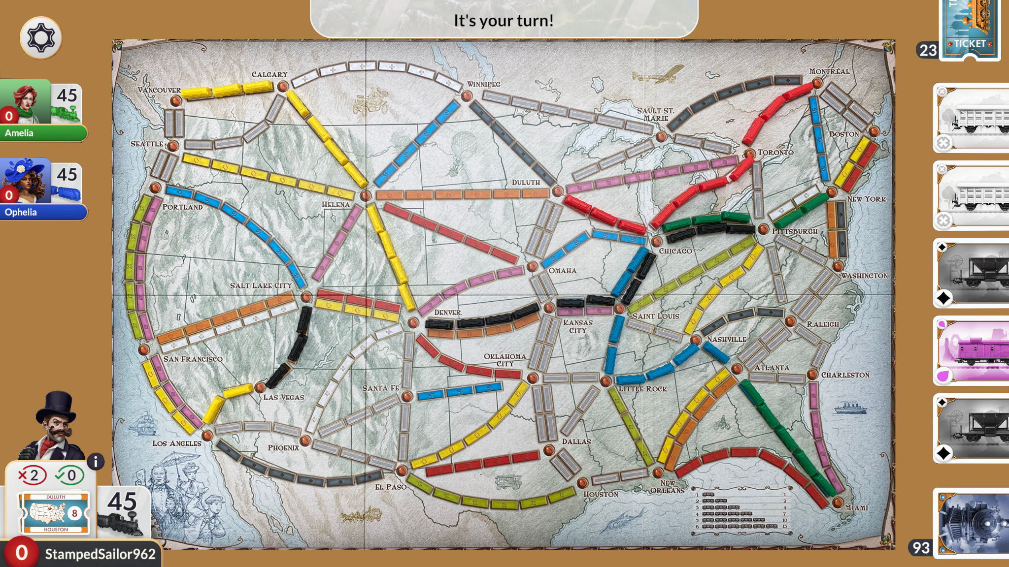
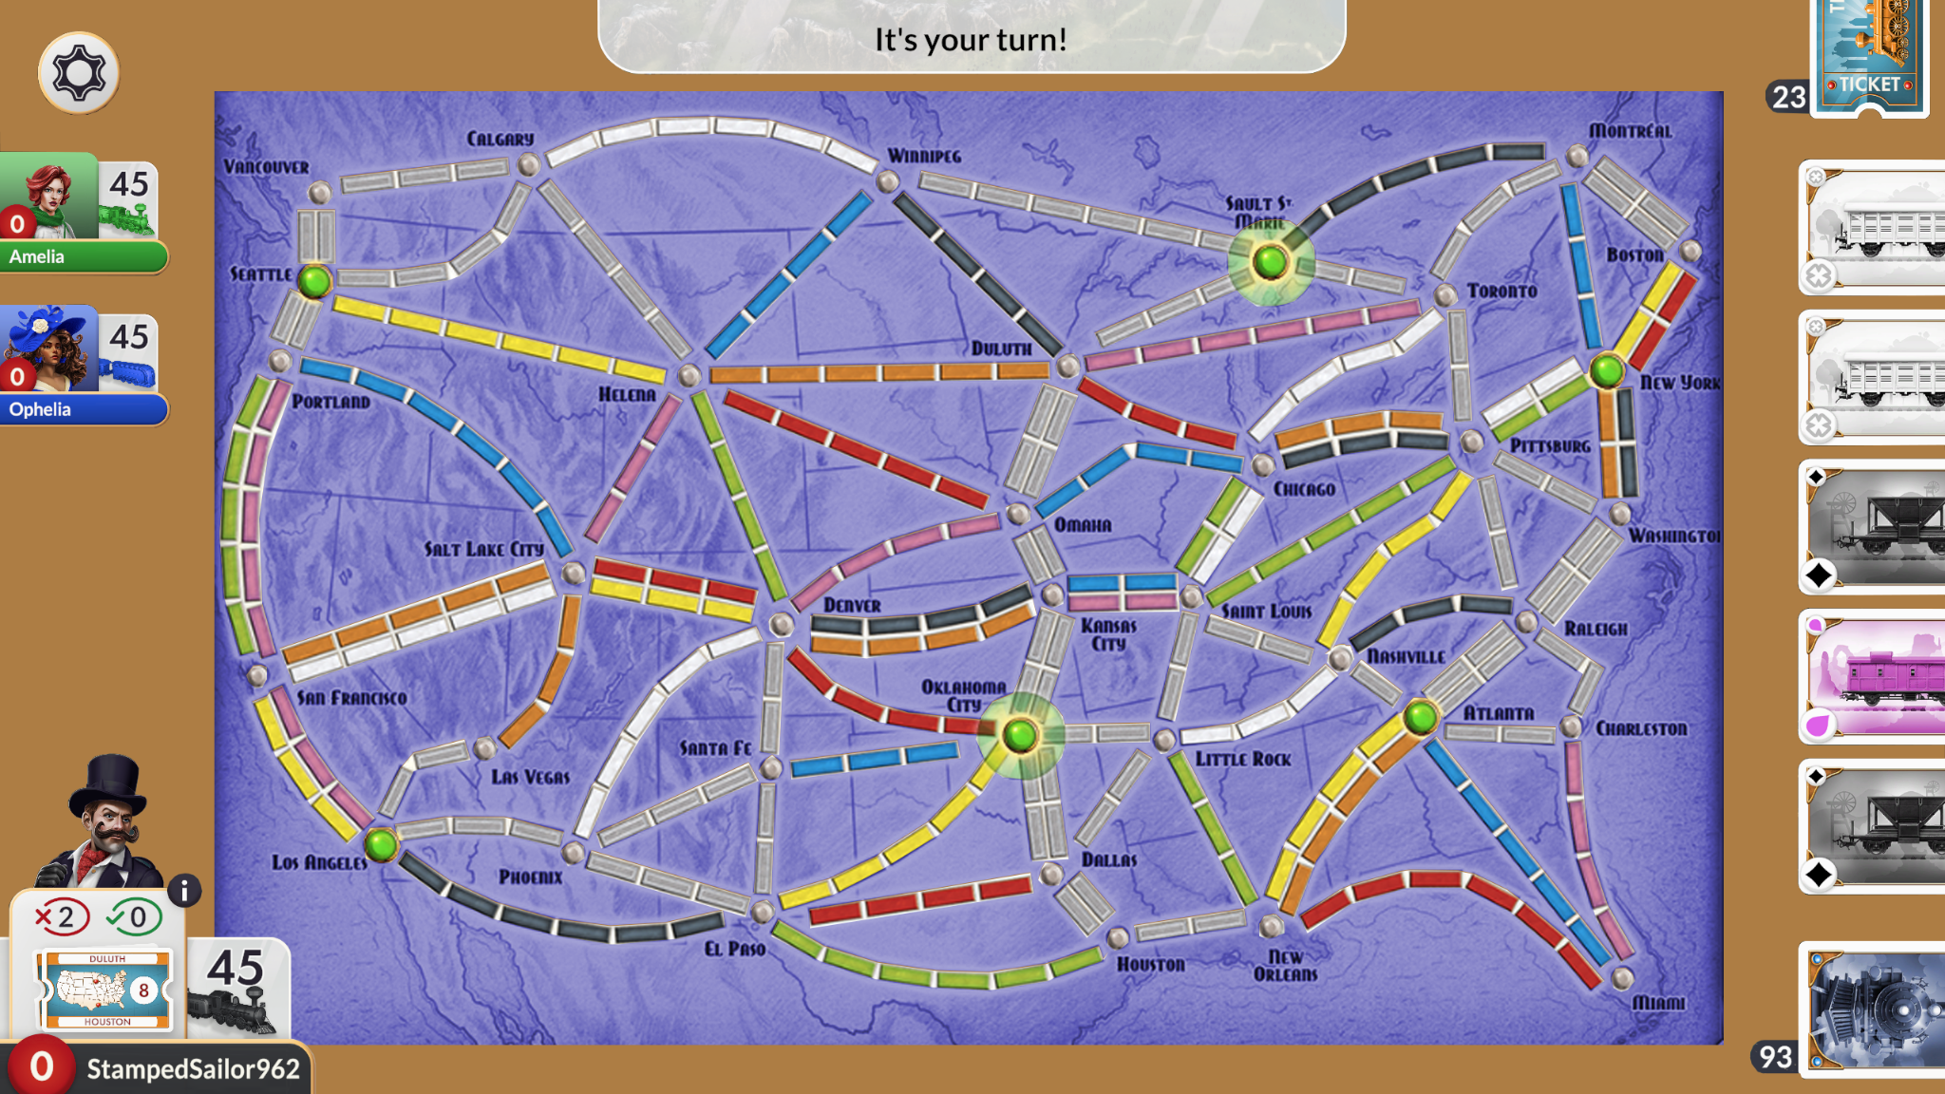
Companion App Size
The companion app will not have the animated 3D map, this is to reduce the size of the companion app, to direct the player’s focus to the TV screen more, and to ensure that the free companion app doesn’t offer the same experience as the paid app. This could take the form of using a copy of the board game board, or a simple 2D version of the map.

